Slide 1
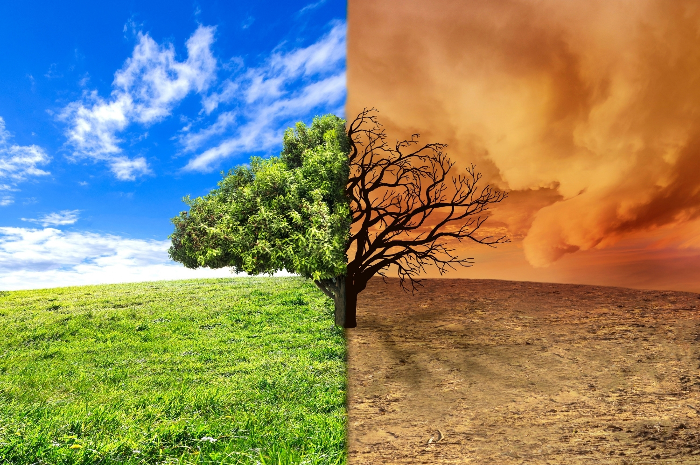


GLOBAL WARMING EFFECTS
ECA Project 2023-1-BG01-KA220-SCH-000160813

Slide 2

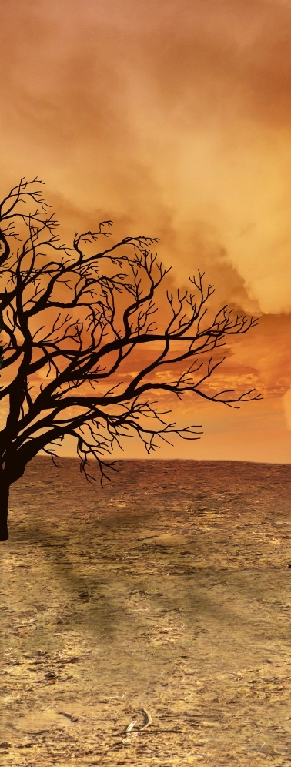

GLOBAL WARMING EFFECTS
Drought

Slide 3
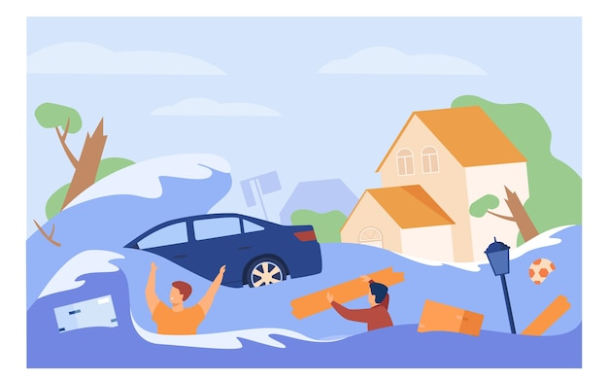
GLOBAL WARMING EFFECTS
Flood

Slide 4

GLOBAL WARMING EFFECTS
Hurricane

Slide 5

GLOBAL WARMING EFFECTS
Ocean Acidification

Slide 6
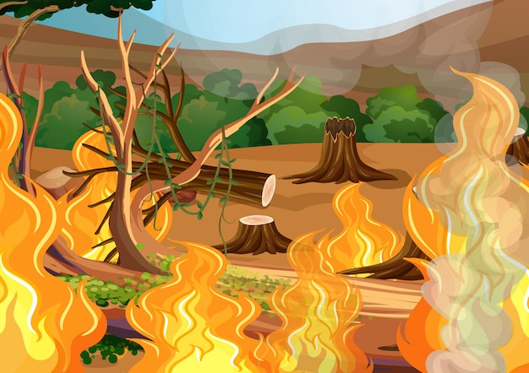
GLOBAL WARMING EFFECTS
Wildfire

Slide 7

GLOBAL WARMING EFFECTS
Melting Glaciers

Slide 8

GLOBAL WARMING EFFECTS
Rising Sea Levels

Slide 9






Module: Ecological awareness
Sub-module: Environmental pollution
Topic: Air and Climate (Global warming)
Resource title: Presentation
Credits: APDNE
2023-1-BG01-KA220-SCH-000160813
All media are within the EU intellectual property law.
Funded by the European Union. Views and opinions expressed are however those of the author(s) only and do not necessarily reflect those of the European Union or the European Education and Culture Executive Agency (EACEA). Neither the European Union nor EACEA can be held responsible for them.

